Slide 1
Social Buzz Analytics

Slide 2

Today's agenda
Project recap
Problem
The Analytics team
Process
Insights
Summary

Slide 3
Project Recap
Social Buzz is a fast growing technology unicorn that need to adapt quickly to its global scale. Accenture has begun a 3 month POC focusing on these tasks.
Conducted an audit of Social Buzz’s big data practices
Cleaned and structured raw data for analysis
Extracted insights on content popularity and user engagement
Provided recommendations for efficient data management
Outlined best practices for a smooth IPO transition

Slide 4
Problem
Rapid scaling has led to massive, unstructured data growth
Lack of big data management expertise
Need for IPO readiness and compliance
Identifying top content categories for strategic focus

Slide 5



The Analytics Team
Andrew Fleming
Chief Technical Architect
Marcus Rompton
Senior principal
Zainab Shaikh
Data Analyst

Slide 6
PROCESS
1
Data Understanding
2
Data Cleaning
3
Data Modelling
4
Data Analysis
5
Uncover Insights

Slide 7
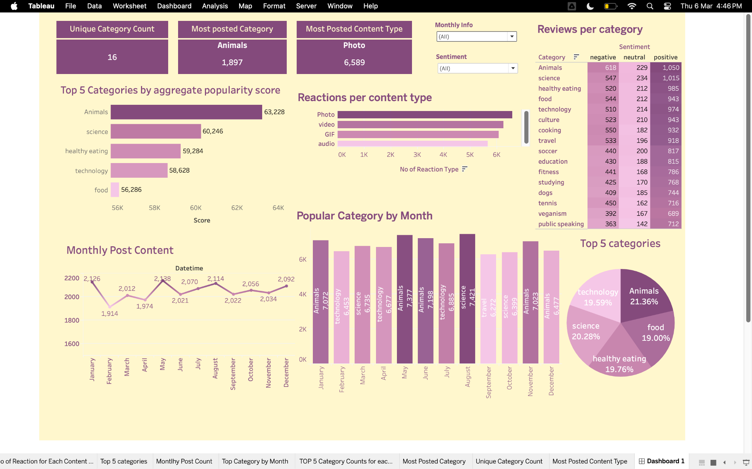
Insights

Slide 8
Live Dashboard Link
https://public.tableau.com/views/Accenture_Social_Buzz_Project/Dashboard1?:language=en-GB&:sid=&:redirect=auth&:display_count=n&:origin=viz_share_link

Slide 9
Summary
Posting more content about animals, science, and technology can help get more likes and shares. Fun posts like quizzes, interesting facts, or behind-the-scenes stories can make them even more popular.
Working with brands or influencers can help reach more people. For example, teaming up with pet care brands for animal content or tech experts for technology posts can attract more attention.
Since photos get the most reactions, using clear and eye-catching images, infographics, or simple guides can make posts more interesting. Trying different types of pictures can help find what people like the most.
Looking at how engagement changes in different months can help plan better posts. Posting more when people are most active and choosing the right topics for each season can increase likes and shares.

Slide 10
Thank You!!!

